Slide 1

House
market analysis
Western Europe countries
Sébastien PAVOT

Slide 2
Agenda Style
01
Topic & Countries
02
Variables and method
03
Relationship strength
04
Countries insights
05
Conclusion

Slide 3








Topic & Countries
2005 – 2018 → Year by Year
Find factors that influence house price index value

Slide 4

Variables and method
18 variables from different Open Source websites
Exchanges rates
Unemployment rate
Life ladder
Confidence in government
Perception of corruption
Stock market value
Inflation rate
Minimum wages
Nominal exchanges rates
Nominal effective exchanges rates
Crime rate
Urban crime rate
Gross domestic product
Life expectancy
Nb of marriages
Pollution
Electricity consumption
Fertility
Sources : OECD / Eurostat / World Hapiness Report / etc…

Slide 5
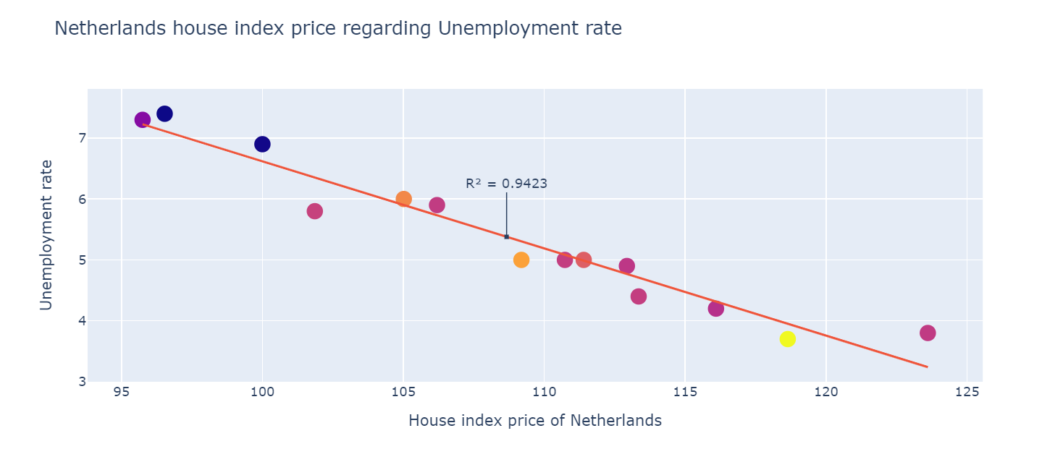
Relationship strength:
Computed on House Index Price value per year with one of variables using a linear regression model.
R² : a value between 0 and 1 to evaluate the strength of the relation ship.

Slide 6

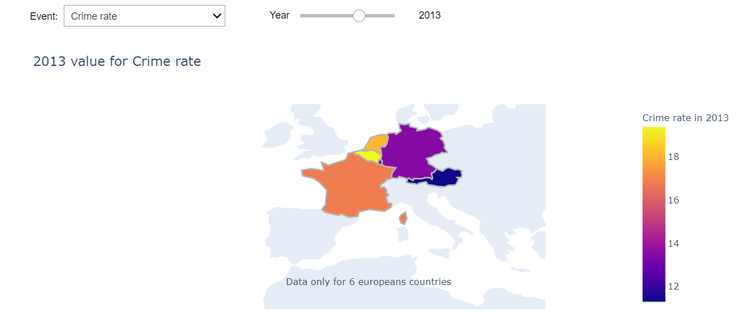
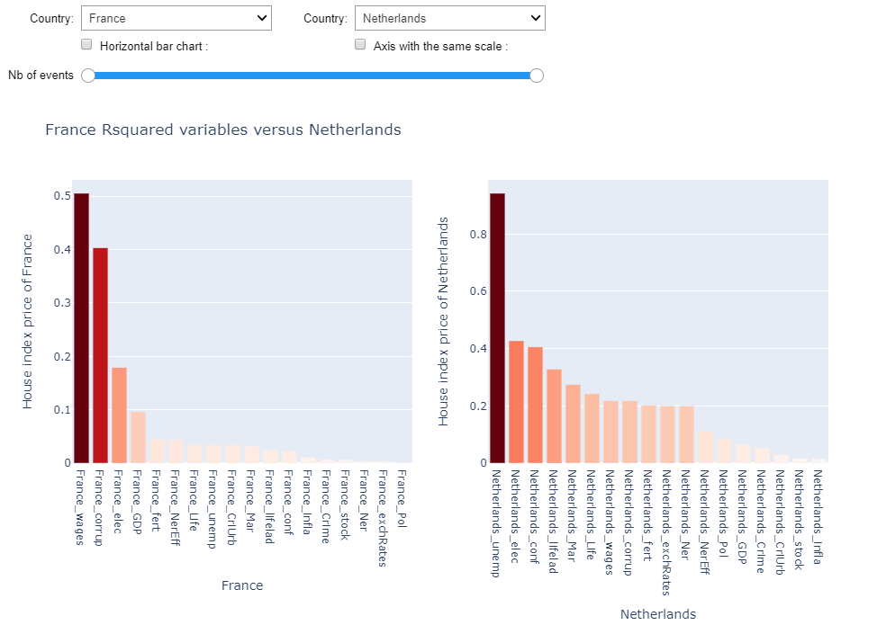
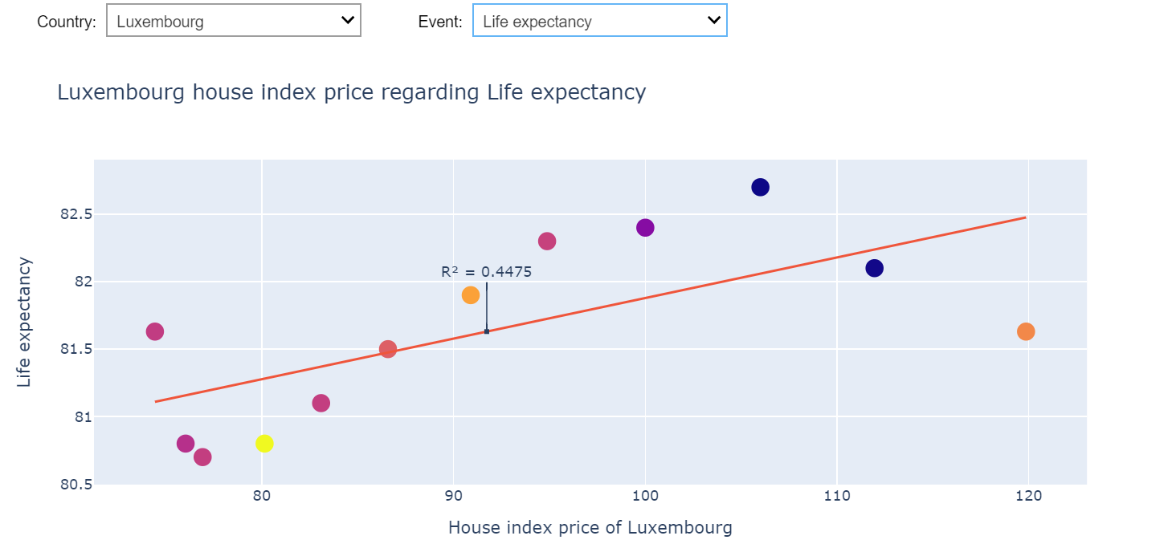
Relationship strength: Visualization
Plotly to create interactive graphs
Sources : https://plot.ly/

Slide 7
Countries insights: France
50%
40%
18%
9%
Perception of corruption
Electricity consumption
Gross domestic product
Minimum wages

Slide 8
Countries insights: Germany
Insert the title of your subtitle Hee
83%
79%
69%
66%
Gross domestic product
Perception of corruption
Minimum wages
Life ladder

Slide 9
Countries insights: Luxembourg
62%
47%
36%
17%
Unemployment rates
Minimum wages
Fertility rates
Inflation rates

Slide 10
Countries insights: Austria
70%
68%
68%
61%
Electricity consumption
Nominal exchanges rates
Exchanges rates
Fertility rates

Slide 11
Countries insights: Netherlands
94%
43%
40%
33%
Unemployment rates
Electricity consumption
Confidence in government
Life ladder

Slide 12
Countries insights: Belgium
44%
39%
22%
21%
Gross domestic product
Unemployment rates
Life ladder
Fertility rates

Slide 13
Conclusion
How to improve ?
Difficulty ?
What next ?
Remark ?
Code isn’t adaptable if we modify the data. Some data might not be linked so we might need to dig more.
Find the data that corresponds to what you’re looking for. Make interactive graphics regarding specificity of each variable.
Collect data to predict how the factors that are relevant will change in the future to predict the house price market.
We didn’t try to input many factors at the same time to predict their importance so we don’t know if some variables are already linked.

Slide 14
Thank you
More analysis to come the next semester…

